Slide 1
Replacing operational work for managerial leather chair - day one
Josip Šaban, M.Sc. Computing, MBA, PMP
PMI Croatia 2020

Slide 2
Short biography
Finished FER in 2004, Cotrugli MBA in 2011
Started as web developer, then moved to databases and business intelligence
Last 5+ years working for Erste Bank, first in Croatia and then moved to Erste Group IT in Vienna, currently in the role of Team Lead in Group DWH sector
In parallel, as owner of sole proprietorship Meridian Data, I provide remote services, mainly on SQL Server, Oracle and Tableau platforms, currently working on a Oracle-to-Azure migration project for a large international corporation
Certified PMP, ITIL Foundation, TOGAF, Scrum Master and Product Owner, ...
Details about my career path and partial portfolio are available at
https://www.linkedin.com/in/josipsaban/
https://jsaban.github.io/ ( conference lecture slides, blogs, MOOC certificates )

Slide 3
Why this lecture?
Because, over and over, experienced IT people go through two scenarios:
Internal promotion to management as only way to advance in the company
Internal or external promotion to management as part of their desired career
Both of these scenarios are great...except when you are not ready

Slide 4
Good and bad reasons for becoming a manager
To be clear - management is art and science of its own, not “extension of technical career”
If you are excellent programer in your own language, IDE and predictable process environment, that says nothing about your management potential
Different skill set is required, which are often not “natural” to engineers
Please read:
Ten reasons Why You Should Become Manager
Seventeen Reasons Not To Be A Manager

Slide 5
Again...why this lecture?
Why are you not ready? Usually it falls into two scenarios:
You finish university where you are trained to become an engineer
You didn’t go to university, started “working” with 18 and by 25 you think that university is a “waste of time” and you only “learn by working”
You are now in 30s, but neither of these paths taught you, in a formal and structured way, the art and science of management
Hopefully you get a first good manager that knows how to manage juniors
I got a very bad first manager, and that moved me to a path of management discovery
It is not the best motivation - you should find your own path - but you have to understand that it is a path not a side activity

Slide 6
If you don’t want this scenario to happen to you...
Like for everything else in life..prepare!
Although I went to MBA, and it is amazing experience, it is not necessary
You have excellent free online resources
I personally really like Coursera
But, some people cannot learn in unstructured way, and then they need a learning path
Personal MBA is amazing resource of best books in various areas of management
Find a mentor that knows and wants to pass knowledge
Again...prepare!

Slide 7
Management and leadership
So…”managers do nothing all day, they just go to meetings and talk”...
If this is your opinion then you either don’t know what they do or you have a very bad manager - in the second case “escape” as soon as possible
But to manage somebody you first have to lead - leading comes first
You have to be a role model in good and bad times
It’s an art, not science - mixture of your creativity, personality and ethics
Management is just a role, leader is something you are or you are not
And yes...it is really OK to change company if you, after honest self-evaluation, are not growing with the pace you think you deserve, it’s a big world
Looking long-term - employment in some company only has meaning if both sides get what they want

Slide 8
Day one...hour one
The day has come - your first day in management - you come to the office...and now what?
You are no longer “protected” by your code, IDE, team and processes - you stand alone
It is quite normal you feel, up to a point, impact of impostor syndrome
In the first week you have to do four major things ( and nothing else! )
Learn your environment
Meet your team and create a team snapshot
Meet your boss, get to know him and learn his expectations
Create overall snapshot
And then...go home and rest - as manager you must learn to disconnect

Slide 9
Task one - learn your environment
This does not mean you to drink coffee in all cafeterias around the building or bother people who are sitting in kitchen...it means:
Get a “feeling” of the team and area - how people talk, is this a formal or informal meeting environment, dress code and how they invite each other lunch
Don’t introduce yourself immediately to everyone showing off in your fancy new suit...you are here to lead, not to impress by outward appearance
If possible, in the first week, except activities listed before, stay low and observe
Expect gossip about you - this is good, it is first step in acceptance
Maybe you will have couple of onboarding sessions with HR - they are amazing opportunity to gather information

Slide 10
Task two - meet your team
You need to form independent view of your team
It is also an amazing opportunity to, informally, learn what were the mistakes of your predecessor, in management practices, and to try to fix them from day one
In the beginning you need to rely on your manager’s observations, but your priority is to start forming opinions about the team
Start asking key questions and look for gaps - how they feel about themselves, their colleagues and as part of the wider company
To create a snapshot you need to combine all these views, compare them against each other and get a “realistic” overview

Slide 11
Task two - meet your team
Introduce yourself to the team - this is the start of building a relationship
Meeting has to be personal - in person or by video link
After it is done you have to make 1-1 with each team member, not more than 30 minutes, according to his schedule, in informal tone
You need to get, from each team member, following information
What is his responsibility
What are they currently working on
Their opinion about the team and what is working well compared to what is not
Summary of this data gets you an overview what the department is actually doing

Slide 12
Task two - meet your team
Schedule difference - makers VS managers - in this post Paul Graham defines key difference between daily schedule of makers and managers
Please read this post from start to finish!
Managers schedule their day around hourly blocks in calendar
Makers are most productive in blocks of about half a day
Don’t be tempted to drop meetings to your staff on your convenience
Sometimes it is unavoidable, but if you can, try to protect their time

Slide 13
Task three - meet your manager
Now it is time for a different kind of meeting - meet your manager
Don’t wait for him to schedule the meeting - be proactive and request his time - it is not rude, it is what he expects
Follow the same procedure - use open-ended questions, listen and take notes - you need to get insights about...everything :)
Most importantly you need to get his opinion of the team, some of his personal ( subjective ) thoughts on their quality ( “superstars” or “average” ), details about clients
You, at any cost, must not leave this meeting without a clear list of your first tasks - they may differ from what you need to do, but you need to manage “up” as much as “down”
Now you are ready for creating your first week snapshot

Slide 14
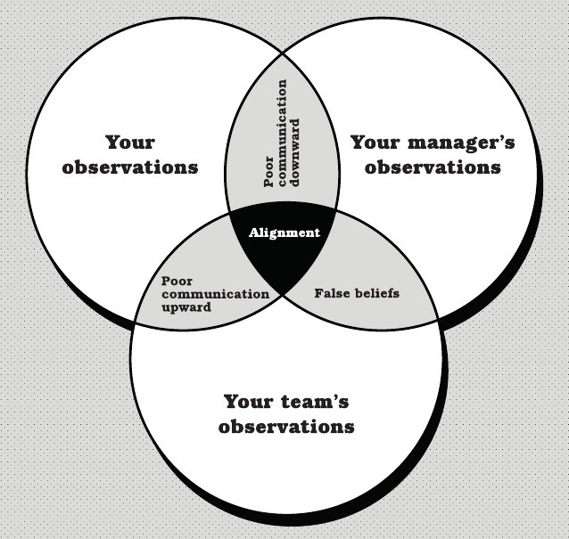
Task four - create your snapshot
You form your snapshot by taking what you’ve learned from the team, your manager, and yourself and create an overlay in a form of Venn diagram
Then you can begin to work out where particular observations fit into the intersecting circles

Slide 15
Task four - create your snapshot
Alignment are observations or beliefs that you, your team, and your manager all share
Poor communication downward is where you and your manager share observations or beliefs, but the team is either unaware or disagrees
Poor communication upward is where you and your team share an observation or belief, but your manager is unaware
False beliefs is where both your manager and the team have a conflicting observation or belief from your own

Slide 16
Task four - create your snapshot
These scenarios can apply to both positive and negative issues
Topics that a good performing team is not aware also require your attention
You won’t be able to solve everything you discover immediately
But this snapshot can form the beginning of productive discussions and investigations, which you have to initiate

Slide 17
Last topic - action list
Now we need to create an action list for week two
You begin with regular one-to-one meetings with your staff and your manager
From snapshot overview you can put observations in some categories which may include things to talk about with your team and things to talk about with your manager.
Then pack your things and head on home, proud in the knowledge that you’ve had a very productive first week

Slide 18
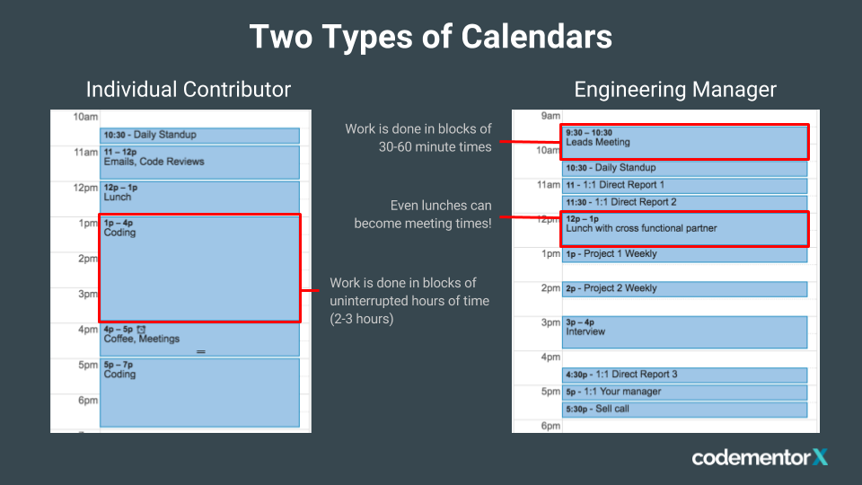
Really last topic - manage yourself
In order to even start week two you need to be ready for something else - self-management
You can read about this in my article, but in general you need some tools and lots of self discipline - your time just became your greatest asset

Slide 19
Really last topic - manage yourself
But, in short, let’s just take a quick look on four key items
Your calendar - for organizing your time
Your to-do list - for organizing your tasks
Your email inbox - for organizing your incoming messages
Your place to capture information - when you’re not in front of other tools.

Slide 20
Now go home and forget about work!
This is extremely important topic - you need to disconnect from work
Your snapshot is done, you met your team, your new boss and you got an initial feeling of the place...it is a lot of work done
Now the week ends, and you disconnect - company doesn’t exist till Monday - your work is done, it is time to relax
How you proceed from there depends on each company and specific demands of that environment, but you made a huge first step
Good luck and I hope you will like management profession

Slide 21
If somebody needs PDU points :)
 | Technical | Leadership | Strategic | PDU Claim Code
Josip Šaban | Kako mekano sletjeti iz operativne gužve u managersku fotelju |  | 1 | C308BHKOLW

Slide 22
Further education
Free online courses ( Coursera, Khan Academy, Udemy, Pluralsight, … )
Books
Advice from mentors and experienced managers
Networking events, conferences, meetups
My contacts:
meridiandatasoftware@gmail.com
josip.saban@erstegroup.com
https://www.linkedin.com/in/josipsaban/ ( Read my posts to continue the story presented in this lecture )
https://jsaban.github.io/ ( Some of my old lectures and presentations )

